Slide 1

RISE
An App for Meditation, Inspiration, Relaxation, and Yoga!

Slide 2



Team Members
Kofi Hayford
Jude Sanchez
Jonathan Gomez

Slide 3
Why we built Rise / Customer Story
AS PEOPLE who have been affected deeply by the pandemic, we all need something to help us clear our energy and improve positive emotions and our mental focus
WE WANT TO provide everyone with multiple resources to help them relax through coordinated deep breathing, meditation, gratitude exercises, and yoga poses.
SO THAT they can have an escape from the day-to-day challenges we encounter.

Slide 4
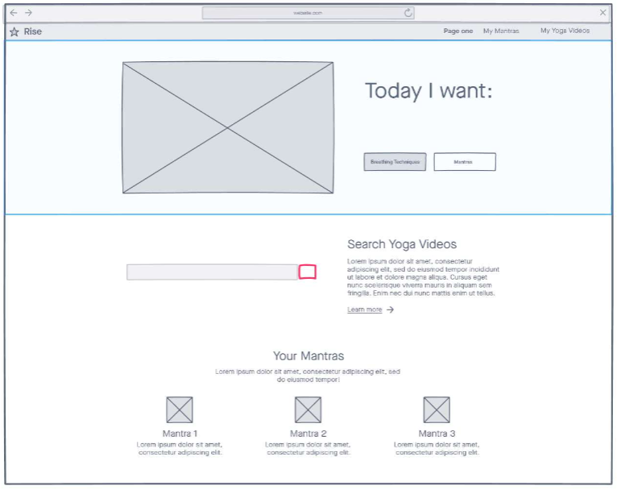

Slide 5
Tools and Resources
HTML, CSS, & Javascript
Semantic UI
Axios
Inspirational Quotes API
SoundCloud API
Luxon
jQuery
GitHub
Colorhunt.io
Wireframe.cc
W3Schools
YouTube

Slide 6
Breakdown of Tasks
Kofi Hayford
Jude Sanchez
Jonathan Gomez
Named the app
Home Page (HTML) & Mantra Content
Yoga Page (HTML, CSS, JS)
Found SoundCloud API
Presentation
Co-Introduced the Avatar Theme
Home Page (CSS, JS)
Music Page (HTML, CSS, JS + API)
Created the dope ass background on the Home Page
Came up with the idea for Rise
Co-Introduced the Avatar Theme
Breathing Page (HTML, CSS & JS)
Daily Affirmations (HTML, CSS, JS + API)

Slide 7
Future Development Opportunities
Embed Music and/or Video into Yoga page so that the exercise demonstrations are more instructive and valuable to the audience.
Make it more mobile optimized or even mobile first.
Use more animations in CSS.
Connect other playlists through Soundcloud and allow users to create and save their own playlists
Implement a Search API of some kind(with certain parameters) so that users can find what they want if it’s not on the app
Add a login/user authentication mechanism that’s tied to a database on the backend
Locate local Yoga Studios or instructors

Slide 8
Challenges/Blockers
Lost a team member
Github repo issues – versions, conflicts, branches, etc.
YouTube API – expense and credits were a concern so we opted for Soundcloud
Spotify API – required user login

Slide 9
Links to the App
GitHub Repository
https://github.com/kofihayford/Rise-App
Rise – Live on GitHub
https://kofihayford.github.io/Rise-App

